Slide 1
Assignment Tracker
Member: Cameron Thompson, Jiahao Cao, D'Vreaux Fontaine, Ben Droste, Gengyu Liu

Slide 2

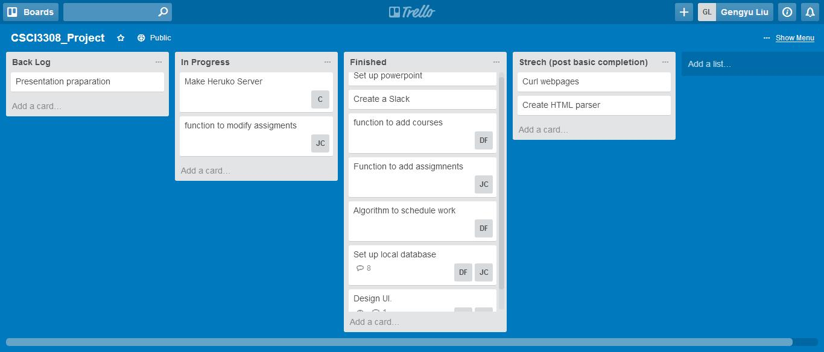
TREllo
Project Tracker
Rating: ☆☆☆
This tool helped us to manage our schedule. But we don’t usually use it.

Slide 3
Slack
Communication
Rating: ☆☆☆☆
Instead of using email, we use slack to chat with each other. It’s quick and convenient for us to discuss in time. Like it said, it’s awesome！

Slide 4


GitHub
VCS Repository
Rating: ☆☆☆☆☆
By using GitHub, we can quick see the changes when someone adds/changes the codes or files. So we don’t need to tell everyone again.

Slide 5

sqlite
Database
Rating: ☆☆☆
SQLite is the suitable for testing during the process of development. Its single file nature ease us from the struggling of dataset sharing.

Slide 6

Pythonanywhere
Testing
Rating: ☆☆☆☆
It is free and easy to set up and use. It provide 24-7 service for free user. It also provides an online interactive python-shell for intuitive project management.

Slide 7

Django
Framework
Rating: ☆☆☆☆☆
Django is a comprehensive web development framework. It provides tons of facilities and shortcuts that free us from re-inventing the wheel.
it’s well-formed and it uses idiomatic python.

Slide 8
Challenges & Problems
Problem with parsing SQLite
Solution: Smashing head against a wall until it worked
Problem with sign up password error
Solution: Fix was stack overflow
Problem with some built in names in Django that caused unintentional shadowing
Solution: Solved by namespacing or renaming user defined variables.

Slide 9
Demo

